Slide 1
Chapter 3: Process-Concept

Slide 2
Process Concept
An operating system executes a variety of programs:
  Batch system – jobs
  Time-shared systems – user programs or tasks
Textbook uses the terms job and process almost interchangeably
Process – a program in execution; process execution must progress in sequential fashion
A process includes:
  program counter
  stack
  data section

Slide 3

Process in Memory

Slide 4
Process State
As a process executes, it changes state
  new: The process is being created
  running: Instructions are being executed
  waiting: The process is waiting for some event to occur
  ready: The process is waiting to be assigned to a processor
  terminated: The process has finished execution

Slide 5

Diagram of Process State

Slide 6
Process Control Block (PCB)
Information associated with each process
Process state
Program counter
CPU registers
CPU scheduling information
Memory-management information
Accounting information
I/O status information

Slide 7

Process Control Block (PCB)

Slide 8

CPU Switch From Process to Process

Slide 9
Process Scheduling Queues
Job queue – set of all processes in the system
Ready queue – set of all processes residing in main memory, ready and waiting to execute
Device queues – set of processes waiting for an I/O device
Processes migrate among the various queues

Slide 10

Ready Queue And Various I/O Device Queues

Slide 11
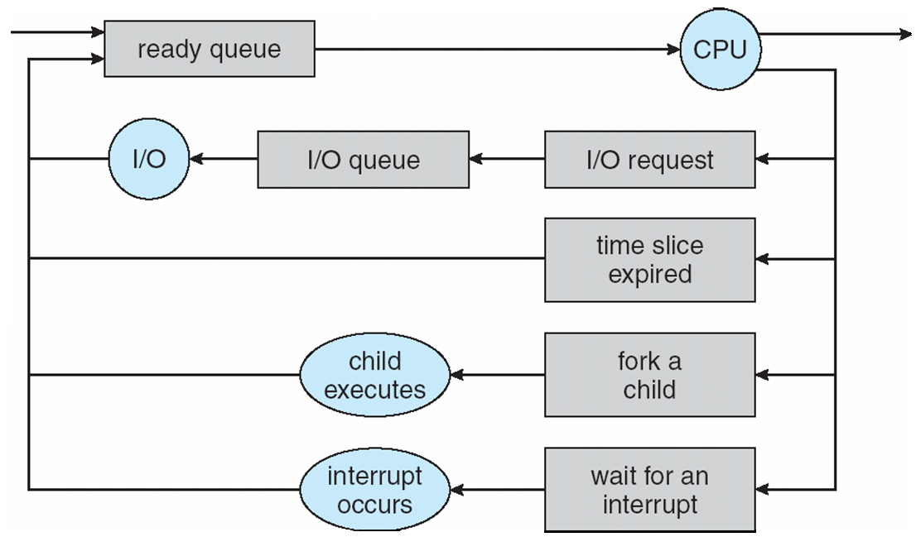
Representation of Process Scheduling

Slide 12
Schedulers
Long-term scheduler (or job scheduler) – selects which processes should be brought into the ready queue
Short-term scheduler (or CPU scheduler) – selects which process should be executed next and allocates CPU

Slide 13
Schedulers (Cont)
Short-term scheduler is invoked very frequently (milliseconds) ⇒ (must be fast)
Long-term scheduler is invoked very infrequently (seconds, minutes) ⇒ (may be slow)
The long-term scheduler controls the degree of multiprogramming
Processes can be described as either:
  I/O-bound process – spends more time doing I/O than computations, many short CPU bursts
  CPU-bound process – spends more time doing computations; few very long CPU bursts

Slide 14
Context Switch
When CPU switches to another process, the system must save the state of the old process and load the saved state for the new process via a context switch
Context of a process represented in the PCB
Context-switch time is overhead; the system does no useful work while switching
Time dependent on hardware support

